Slide 1
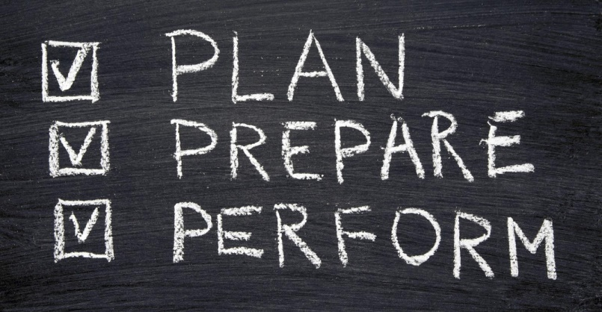
Monday, May 20, 2019 6-It’s a Small World!
 | Prepare for the EOC.
Bell work | 60 Second Civics
Classwork | EOC Prep Check packets Jeopardy
Homework | Study for EOC! For those testing tomorrow, get a good night’s rest and eat a good breakfast! Tomorrow is the Civics EOC!

Slide 2
Tuesday, May 21, 2019 6-It’s a Small World!
 | Prepare for the EOC.
Bell Work | Political Cartoon Analysis
Classwork | EOC Prep
Homework | Get a good night’s rest and eat a good breakfast! Tomorrow is the Civics EOC!

Slide 3
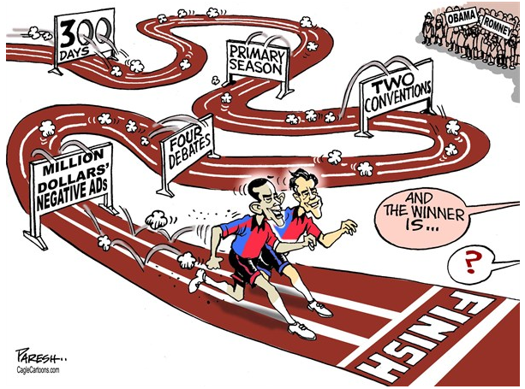

Slide 4
Wednesday, May 22, 2019 6-It’s a Small World!
 | Show what you know!
Bell Work | 60 Second Civics
Classwork | Civics EOC
Homework | Rejoice! Recover! Rejuvenate!

Slide 5
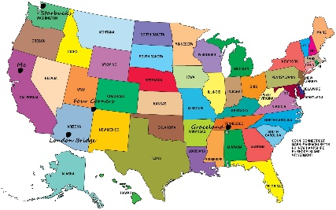
Thursday, May 23, 2019 6-It’s a Small World!
 | Locate the 50 states and their capital cities on a map.
Bell Work | Political Cartoon Analysis
Classwork | States and Capitals Label map with name of state List capitals and states, according to numbers on map.
Homework | Practice states and capitals.

Slide 6
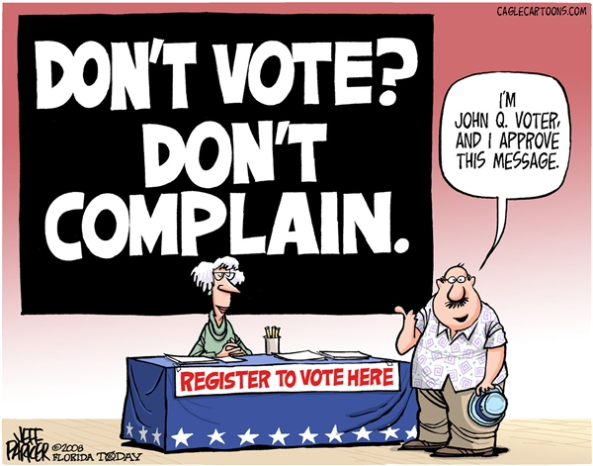

Slide 7
Friday, May 24, 2019 7-From Sea to Shining Sea!
LEQ | Locate the 50 states and their capital cities on a map.
Bell Work | CNN 10-Examine multiple perspectives on public and current issues.
Classwork | States and Capitals Label map with name of state List capitals and states, according to numbers on map.
Homework | Happy Memorial Day!

