Slide 1
Tuesday, April 30, 2019 6-It’s a Small World!
LEQ | Describe the types of international influence and their possible effects on a nation.
Bell Work | Political Cartoon analysis:
Classwork | International Influence Finish activity pages International Organizations Begin reading and activity page independently
Homework | Get a good nights sleep for testing!

Slide 2
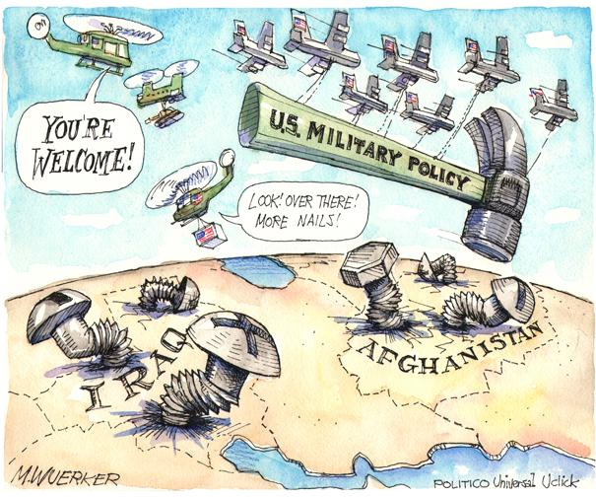

Slide 3
Wednesday, May 1st, 2019 6-It’s a Small World!
LEQ | Describe the types of international influence and their possible effects on a nation.
Bell Work | 60 Second Civics
Classwork | No More Baths As you watch the video, shade in boxes that match what we’ve covered in class throughout the year
Homework | Get a good nights sleep for testing!

Slide 4
Friday, May 3rd, 2019 6-It’s a Small World!
LEQ | Describe the types of international influence and their possible effects on a nation.
Bell Work | CNN10 – make real world connections!
Classwork | Finish “No More Baths” Complete International Organizations – Due Monday…..
Homework | Have a stellar weekend!

