Slide 1
Monday, April 15, 2019 5-You Decide!
 | Examine the electoral process and explain how it is implemented in the US.
 | Bad Kitty for President-Explain campaign process and voting process.
Classwork | The Electoral Process Electoral College Review activity page
Homework | Complete Electoral Process, as necessary. Test on elections on Wednesday.

Slide 2
Tuesday, April 16, 2019 5-You Decide!
 | Identify America’s current political parties, and illustrate their ideas about government.
Bell Work | Bad Kitty for President-Explain campaign process and voting process.
Classwork | Party On! www.floridastudents.org Complete tutorial on SS.7.C.2.8 Identify similarities and differences in major political parties. How do 3rd parties impact an election
Homework | Finish Electoral Process A-F. Due tomorrow

Slide 3
Wednesday, April 17, 2019 5-You Decide!
 | How do I prepare for voting in an election?
Bell Work | bellwork
Classwork | Finish “Party On!” Distribute workbooks and prepare for test on voting and electoral process.
Homework | Review workbook ch. 11 and study practice tests

Slide 4
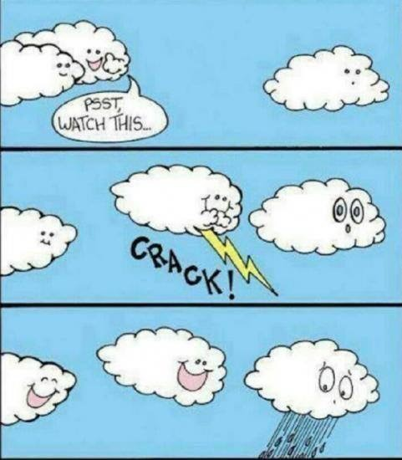

Slide 5
Wednesday, April 17, 2019 5-You Decide!
 | Examine the electoral process and evaluate candidates and the impact the media has on elections.
Bell Work | Bad Kitty for President-Explain campaign process and voting process.
Classwork | Voting and Elections Test
Homework | Review Progress monitoring report for quarter exams. Get parent signature.

Slide 6
Thursday, April 18, 2019 6-It’s a Small World!
 | Differentiate concepts related to US domestic and foreign policy.
Bell Work | CNN10 – make real world connections!
Classwork | Test on voting and the electoral process. Review and grade electoral process.
Homework | Have a stellar weekend!

Slide 8
Friday, April 19, 2019 6-It’s a Small World!
LEQ
Bell Work | CNN 10-Examine multiple perspectives on public and current issues.
Classwork | Good Friday—No School
Homework | Have a great weekend!

