Slide 1
Monday, April 1, 2019 5-You Decide!
 | Analyze how media groups impact the government.
Bell Work | 60 Second Civics
Classwork | Review Role of Media Complete Activity Pages
Homework | Complete Role of Media, as needed.

Slide 2
How has the media evolved throughout American History?
-From the founding of the country to the end of
the 19th century news media was a very, very
local issue. Could there be a reason for this?

Slide 3
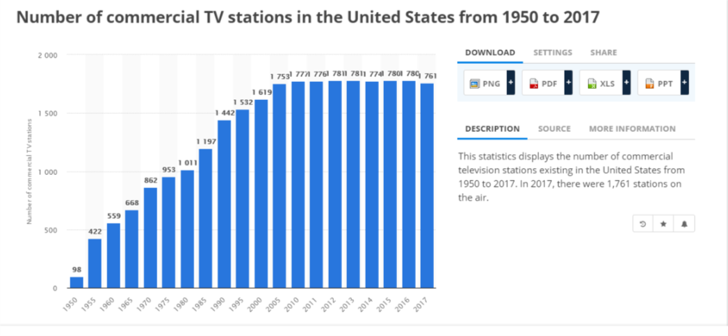

Slide 4
1st: Double-check your work from Friday (matching media headlines to newspaper agendas).
2nd: Complete “Role of the Media” activity page.
3rd: if done, answer the extended response in 4-5 sentences – “How has media evolved throughout American History?

Slide 5
Tuesday, April 2, 2019 5-You Decide!
 | Evaluate candidates for political office.
Bell Work | Pascua Florida Day https://www.youtube.com/watch?v=jKs_pdWwKUQ
Classwork | Candidate Evaluation Read and highlight Evaluate candidates Check for understanding
Homework | Make a list of the top 5 issues you would want a presidential candidate to address.

Slide 6
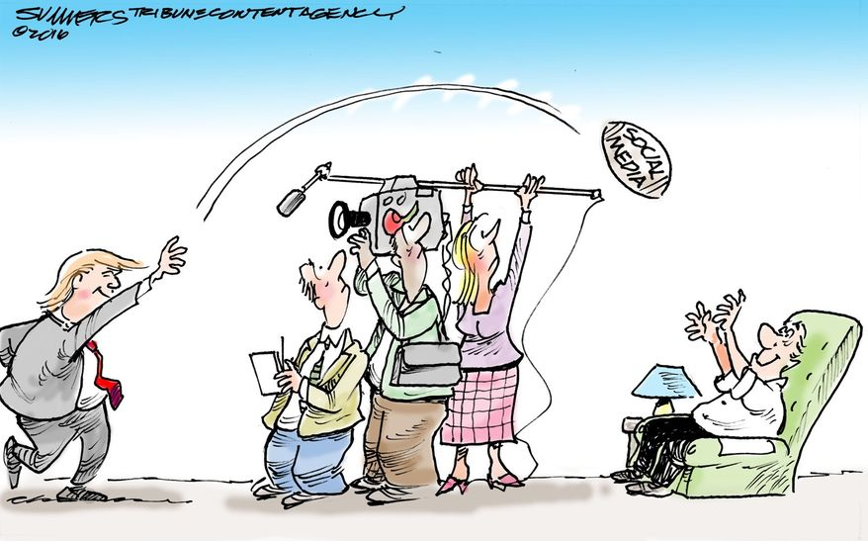

Slide 7
Wednesday, April 3, 2019 5-You Decide!
 | Evaluate candidates for political office.
Bell Work | 60 Second Civics
Classwork | FSA Writing Assessment Day Civics Review
Homework | Make a list of the top 5 issues you would want a presidential candidate to address. (reviewing for bellwork tomorrow)

Slide 8
Thursday, April 4, 2019 5-You Decide!
 | Evaluate candidates for political office.
Bell Work | Share list of issues you want a presidential candidate to address.
Classwork | Candidate Evaluation Review Evaluate candidates Check for understanding
Homework | Complete Candidate Evaluation, as needed.

Slide 10
Friday, April 5, 2019 5-You Decide!
LEQ | Analyze media and political communications and their influence on government.
Bell Work | CNN 10-Examine multiple perspectives on public and current issues.
Classwork | Check Candidate Evaluation, as needed. Propaganda: What’s the Message Read and highlight Evaluate different forms of media
Homework | Have a great weekend!

