Slide 1
Monday, April 8th, 2019
TARGET | Analyze historical interpretations of the Mexican-American War.
BELLWORK | Have out Texas & Florida reading essentials
CLASSWORK | Interpreting History: The Mexican-American War Source analysis Causes of war Venn diagram Small group conclusions
HOMEWORK | None

Slide 2
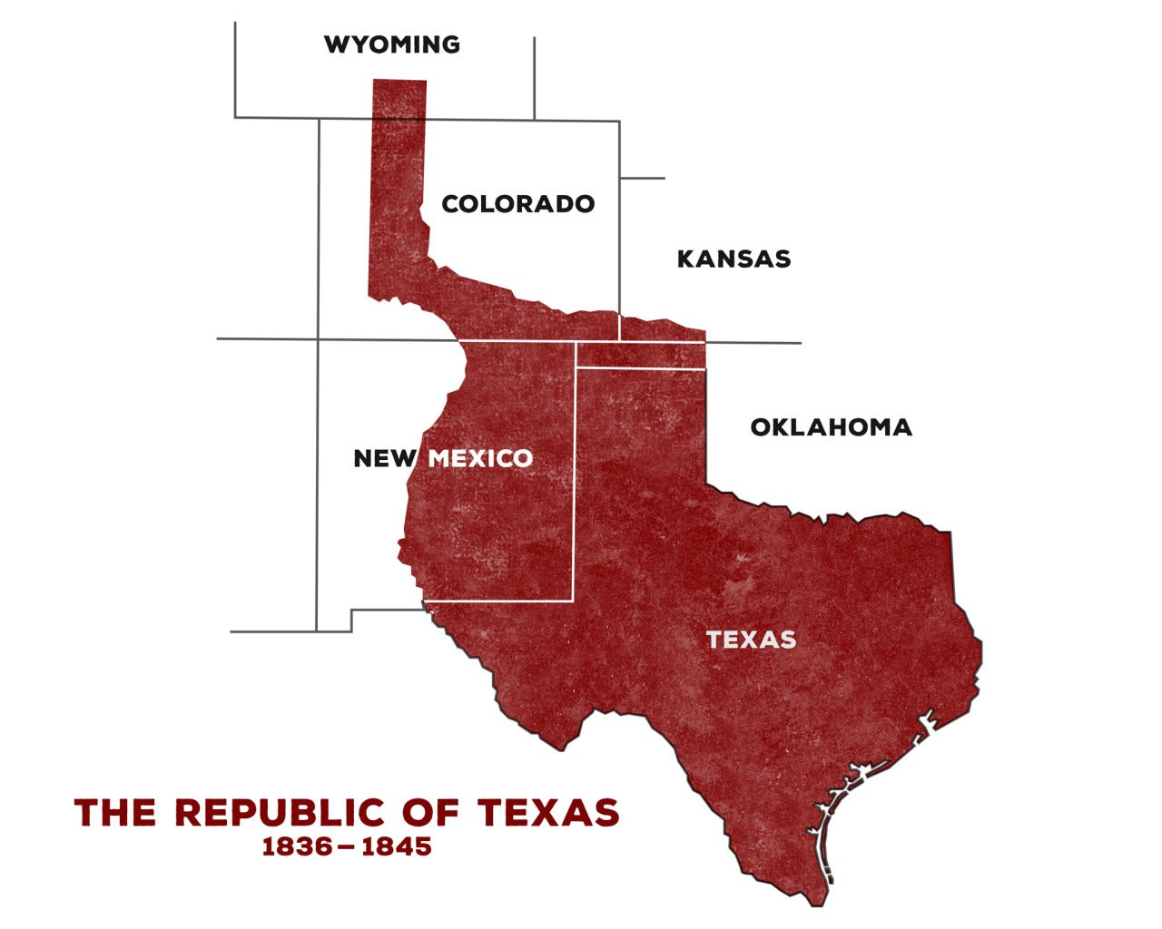
Review
After the annexation of Texas in 1845 Mexico still claimed the southwest as its land.
Tensions rose between the two countries until war finally began

Slide 3
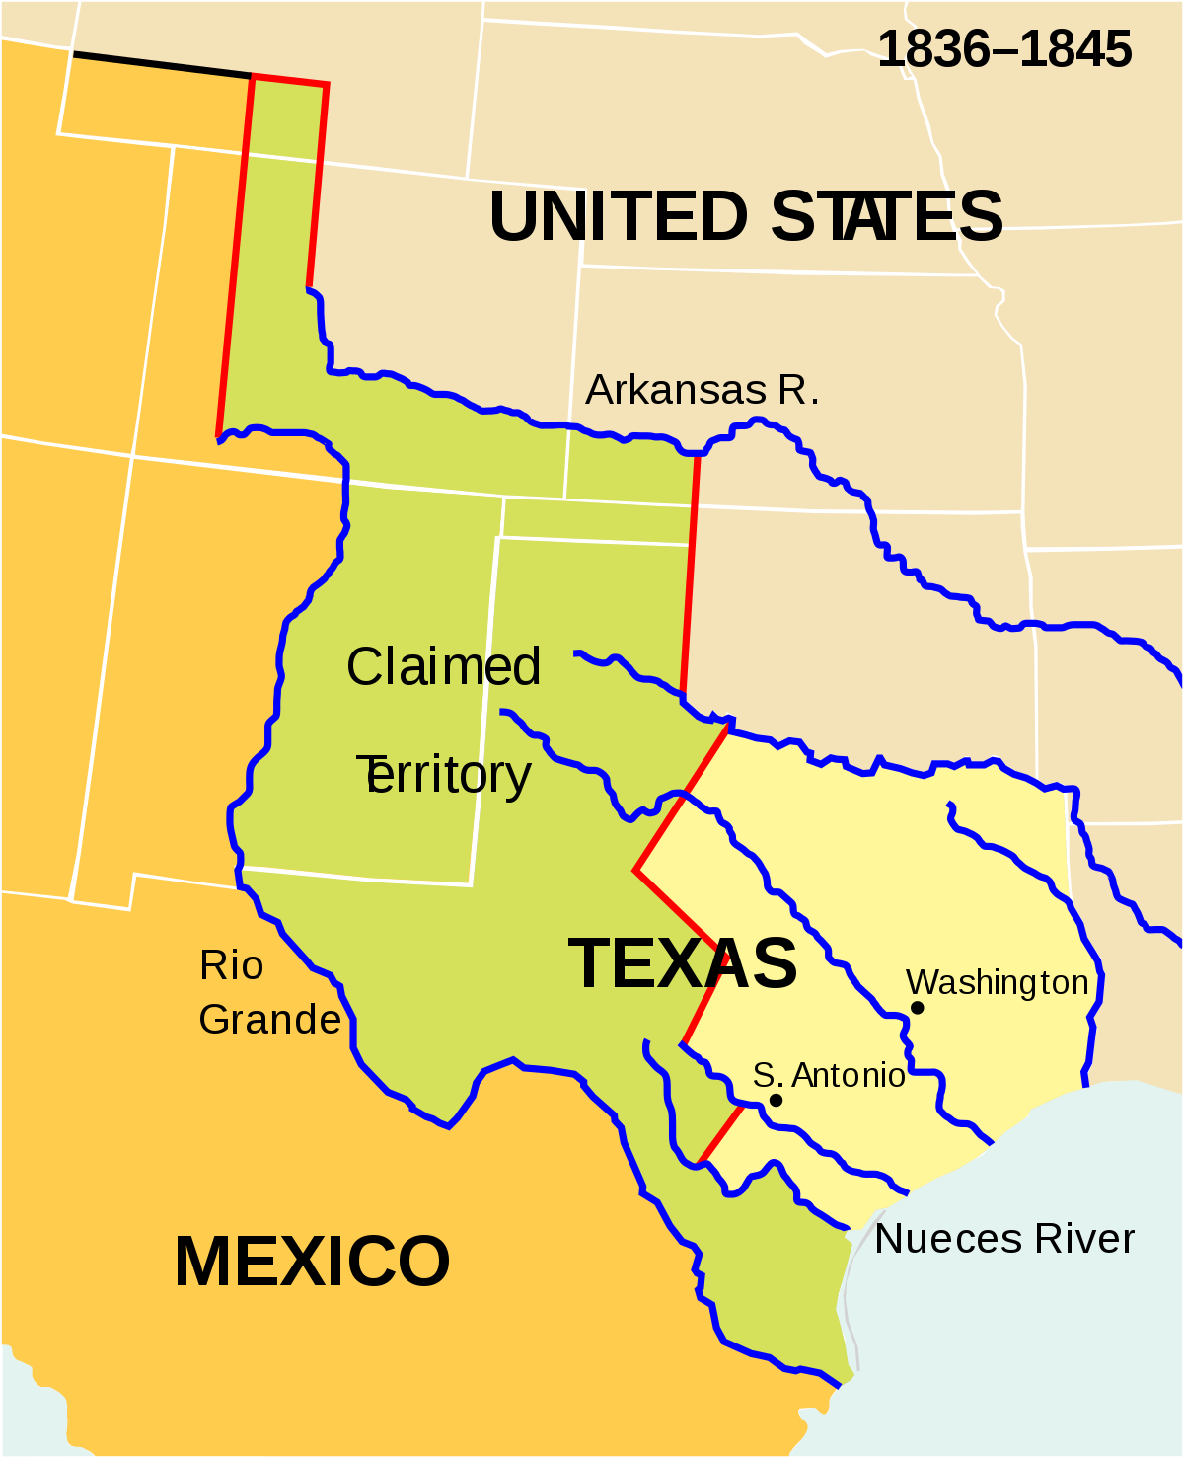
Mexico said the U.S. government illegally brought Texas into the union and had no right to its ‘claimed’ territory.
The boundary of Texas was never agreed to and both Mexican and U.S. soldiers are stationed along the Nueces Strip (red).

Slide 4
Source: Henry William Elson and Cornelia Eliza MacMullan, The Story of Our Country (New York: Thompson Brown Company; Johnson, Blagen & Co., 1911) [modified text]
President Polk, fearing an attack, sent General Zachary Taylor to the disputed territory. And not many days passed before General Taylor received a letter from the Mexican general, Ampudia….. “I require you to break up your camp and retire to the other bank of the Nueces River. If you insist upon remaining upon the soil, it will clearly result that weapons, and weapons alone, must decide."
What was General Taylor's answer? "The instruction I am acting by will not allow me to go back from my position. I regret the alternative that you offer, but, at the same time, wish it understood that I shall by no means avoid such an alternative, leaving the responsibility with those who (foolishly start conflicts)."
It was not long after this that war was declared. General Taylor did not wait for more soldiers to arrive, but marched on and defeated the Mexicans near the mouth of the Rio Grande, although they outnumbered him. The enemy fled across the river, but Taylor followed them and captured the town of Matamoros. He then moved up the Rio Grande to besiege Monterey, one of the most strongly fortified cities of Mexico.

Slide 5
Source: James W. Davidson and Michael B. Stoff, The American Nation(Englewood Cliffs, NJ: Prentice Hall, 1995), 366 [modified text]
In January 1846, Polk ordered General Zachary Taylor to cross the Nueces River and set up posts along the Rio Grande. Polk knew that Mexico claimed this land and that the move might spark a war. In April 1846, Mexican troops crossed the Rio Grande and fought briefly with the Americans. Soldiers on both sides were killed.
President Polk claimed that Mexico had "shed American blood upon the American soil." At his urging, Congress declared war on Mexico. Americans were divided over the war. Many people in the South and West wanted more land and so were eager to fight. Northerners, however, opposed the war. They saw it as a southern plot to add slave states to the Union.

Slide 6
Discussion Questions
1. Why might these two textbooks have different stories for the beginning of war with Mexico?
2. Which source does your group believe more? Think of at least two good reasons why.

Slide 7
Tuesday, April 9th, 2019
TARGET | Analyze historical interpretations of the Mexican-American War.
BELLWORK | Reading essentials and a grading pen…
CLASSWORK | Interpreting History: The Mexican-American War Finish Venn-diagrams Complete visual of your interpretation of the start of the Mexican-American war.
HOMEWORK | None

Slide 8
Wednesday, April 10th, 2019
TARGET | Describe how the gold rush led settlers west
BELLWORK | What was President Polk’s plan for defeating Mexico? (p.369)
CLASSWORK | Manifest Destiny – War and Gold Complete 13.3 & 13.4 quizzes on American expansion westward. Finish Mexican war visual display, if needed. Volunteers to present
HOMEWORK | Finish 13.3 and 13.4

Slide 9
What was President Polk’s plan for defeating Mexico? (p.369)
Drive Mexican army out of Texas
Seize/capture New Mexico and California
Invade Mexico and capture Mexico City

Slide 10
Tasks for today….
Try the quizzes first on a separate piece of paper. See if you can predict any of the answers!
2. Read through lessons 3 and 4
3. Complete 13.3 and 13.4 quizzes before the end of class.
4. Continue working on Mexican-American War visual
displays, if you have time.

Slide 11
Thursday, April 11th, 2019
TARGET | Review concepts of Manifest Destiny and westward expansion.
BELLWORK | Have out 13.3/4 quizzes and a grading pen.
CLASSWORK | Manifest Destiny Review for chapter 13 quiz tomorrow
HOMEWORK | Study for quiz!

Slide 13
Friday, April 12th, 2019
TARGET | Describe concepts of Manifest Destiny and American westward expansion.
BELLWORK | Bellwork
CLASSWORK | Manifest Destiny Chapter 13 Quiz today
HOMEWORK | Have a stellar weekend

