Slide 1
Bellwork Quiz Friday!
Tuesday, March 12, 2019
TARGET | Identify key events during Andrew Jackson’s presidency that contributed to American expansion.
BELLWORK | Have out source chart
CLASSWORK | The Age of Jackson Finish source questions TODAY! If done, begin forming an opinion of whether President Jackson was democratic enough and form source arguments into beginning paragraphs.
HOMEWORK | Finish, if needed.

Slide 2
Wednesday, March 13, 2019
TARGET | Identify key events during Andrew Jackson’s presidency that contributed to American expansion.
BELLWORK | A man is 24 years old but has only had 6 birthdays. How is that possible?
CLASSWORK
HOMEWORK | Chapter 12 key terms due tomorrow!

Slide 3
Bellwork Quiz tomorrow!
Thursday, March 14, 2019
TARGET | Identify key events during Andrew Jackson’s presidency that contributed to American expansion.
BELLWORK | Was Andrew Jackson better or worse for American democracy? Explain (2 sentences)
CLASSWORK | How Democratic was Andrew Jackson? Check source charts Crafting a delicious essay
HOMEWORK | Finish planning sheet, if needed. Re-read essay and think of improvements.

Slide 4
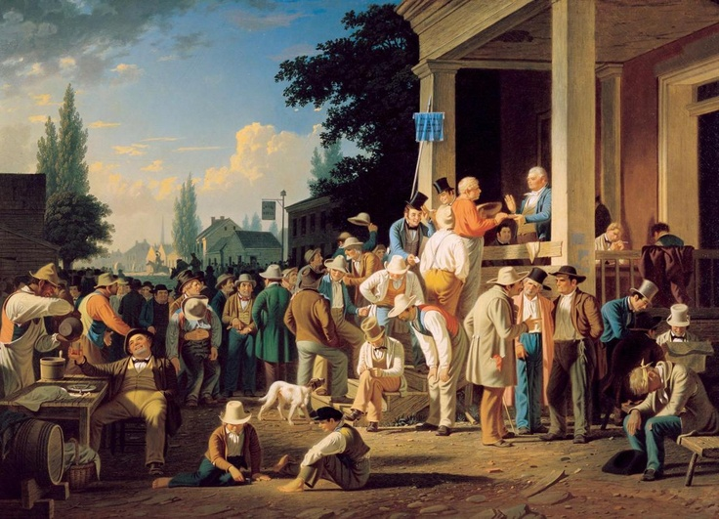
Don’t:
“Andrew Jackson was democratic because according to document 1 he was democratic and popular….”
Do:
“Andrew Jackson was a controversial president that you either liked or didn’t like. Some of the reasons include…..”

Slide 5
Democracy
The government listens to the will of the people.

Slide 6
Friday, March 15, 2019
TARGET | Identify key events during Andrew Jackson’s presidency that contributed to American expansion.
BELLWORK | Why is an older $100 bill worth more than a new one?
CLASSWORK | Bellwork quiz – 3rd nine weeks The Age of Jackson DBQ “How Democratic was Andrew Jackson?” Complete essay
HOMEWORK | Essay due on Monday

Slide 7
Why is an older $100 bill worth more than a new one?
A $100 bill is worth more than $1….

Slide 8
Bellwork Quiz – 3/15
DO NOT NEED TO WRITE THE QUESTIONS
1. I have two arms, but fingers none. I have two feet but cannot
run. I carry well but best with my feet off the ground. What am I?
2. Write your answer to the bellwork for February 12th.
3. What was the bellwork question for February 22nd?
4. What is another name for the Florida Purchase Treaty?

