Slide 1
Monday, March 4, 2019
TARGET | Identify major domestic and international events during James Madison’s Presidency
BELLWORK | How many candidates ran in the election of 1824? Include names (p.330)
CLASSWORK | Review chapter 11 quiz History Channel – Andrew Jackson Chapter 12, Lesson 1 – Jacksonian Democracy Read as a class
HOMEWORK | None

Slide 2
How many candidates ran in the election of 1824? Include names (p.330)
Four candidates ran:
William Crawford
Andrew Jackson
Henry Clay
John Quincy Adams

Slide 3
Tuesday, March 5, 2019
TARGET | Identify key events during Andrew Jackson’s presidency that contributed to American expansion.
BELLWORK | What was the ‘spoils system’ of the Jackson administration? (ch. 12, L.1)
CLASSWORK | The Age of Jackson Guided Notes – Jacksonian Democracy Chapter 12 key terms
HOMEWORK | Chapter 12 key terms due Thursday

Slide 4
What was the ‘spoils system’ of the Jackson administration?
The practice of handing out government jobs to supporters; replacing government employees with the winning candidates supporters.

Slide 5
Wednesday, March 6, 2019
TARGET | Identify key events during Andrew Jackson’s presidency that contributed to American expansion.
BELLWORK | A man is 24 years old but has only had 6 birthdays. How is that possible?
CLASSWORK | The Age of Jackson Finish guided notes on Andrew Jackson’s Presidency Introduction to DBQ
HOMEWORK | Chapter 12 key terms due tomorrow!

Slide 6
A man is 24 years old but has only had 6 birthdays. How is that possible?
The man’s birthday is February 29th…..on a leap year.

Slide 7
Thursday, March 7, 2019
TARGET | Identify key events during Andrew Jackson’s presidency that contributed to American expansion.
BELLWORK | Describe Jacksonian Democracy
CLASSWORK | Chapter 12 Key Terms due today The Age of Jackson DBQ “How Democratic was Andrew Jackson?” Background Essay Decoding terms
HOMEWORK | Re-read essay on President Jackson

Slide 8
Describe Jacksonian Democracy
Majority rules – people who win the vote get to make decisions. Expanded voting rights to people.

Slide 9
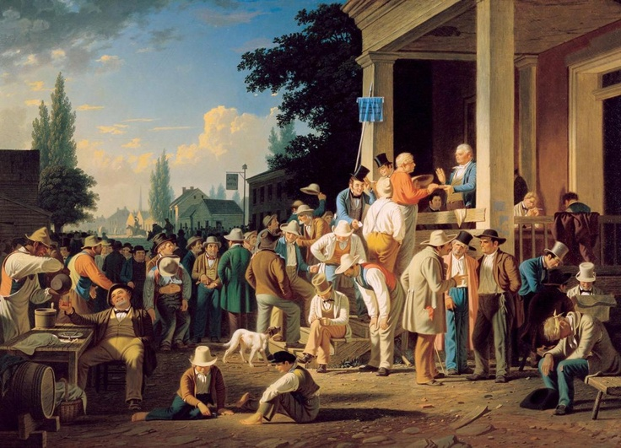
Age of Jackson
1824-1844
“How Democratic was Andrew Jackson?”

Slide 10
Friday, March 8, 2019
TARGET | Identify key events during Andrew Jackson’s presidency that contributed to American expansion.
BELLWORK | Have DBQ Essay on desk
CLASSWORK | The Age of Jackson DBQ “How Democratic was Andrew Jackson?” Source analysis How do we analyze historical sources?
HOMEWORK | None

Slide 11
Document #1
Topic: How the President is
elected
(Hint – Andrew Jackson was elected in 1828 and 1832…)

