Slide 1
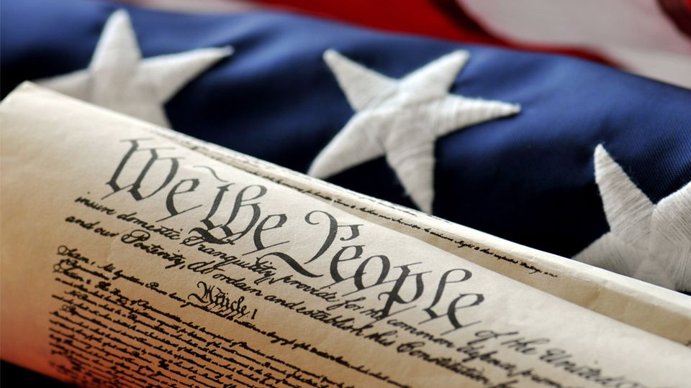
MONDAY, February 25, 2019
TARGET | Identify major domestic and international events during James Madison’s Presidency
BELLWORK | Can you name a major invention of the Industrial Revolution?
CLASSWORK | “I Love Lucy” – Chocolate Factory Factory Simulation – Do the job assigned to you as quickly and efficiently as possible. If you don’t, YOU’RE FIRED!
HOMEWORK | Complete factory simulation response questions, if needed.

Slide 2
Tuesday, February 26, 2019
TARGET | Identify major domestic and international events during James Monroe’s Presidency
BELLWORK | 1. Can you see any advantage to being an artisan worker instead of a factory worker? 2. How do you think the factory system both helped and hurt the United States during the Industrial Revolution? DO NOT WRITE QUESTIONS TODAY
CLASSWORK | Doodle Notes – The Era of Good Feelings The American System and a compromise in Missouri
HOMEWORK | Complete doodle note blanks, if needed.

Slide 3
Wednesday, February 27, 2019
TARGET | Identify major domestic and international events during James Monroe’s Presidency
BELLWORK | What is another name for the Florida Purchase Treaty?
CLASSWORK | Doodle Notes – The Era of Good Feelings The American System and a compromise in Missouri Complete fill-in-the-blanks and reflection questions on James Monroe’s presidency. Color notes once reflection questions are done
HOMEWORK | Complete reflection questions, if needed

