Slide 1
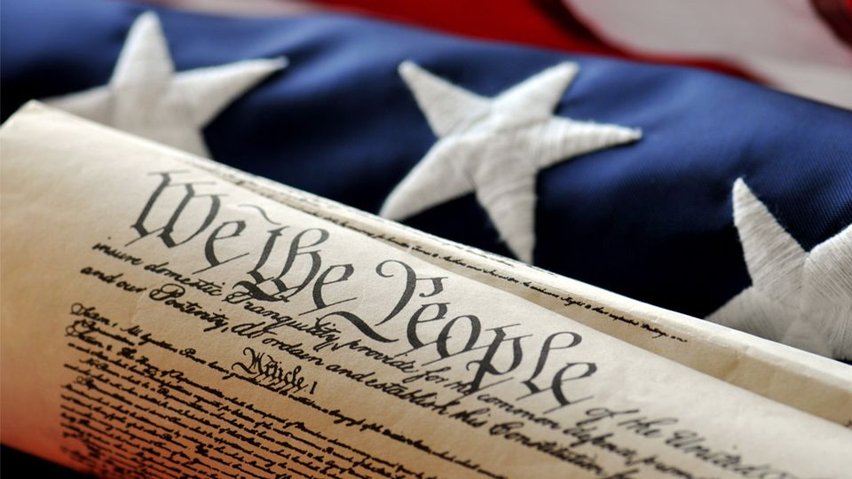
TUESDAY, FEBRUARY 19, 2019
TARGET | Identify major domestic and international events during James Madison’s Presidency
BELLWORK | Have Table of Contents on desk
CLASSWORK | Creating a Presidential FakeBook (a what?) Choose one of the first four U.S. Presidents and design a social media page reflecting their life and time in office. Be creative! --- Include relevant historical facts based on what we’ve learned about the Presidents.
HOMEWORK | Gather more information on your President

Slide 2
by the end of class….
Know:
Which President you’ve chosen
President’s birthday, age
three important facts about their life.
Begin one post on the timeline.

Slide 3
WEDNESDAY, FEBRUARY 20, 2019
TARGET | Identify major domestic and international events during James Madison’s Presidency
BELLWORK | Have out FakeBooks and textbooks
CLASSWORK | Continue working on FakeBooks By the end of class you should have: Three posts on timeline regarding key events in their Presidency Comments from their friends list to the original post threads All comments must be descriptive!
HOMEWORK | Finish above parts, if needed.

Slide 4
THURSDAY, FEBRUARY 21, 2019
TARGET | Identify major domestic and international events during James Madison’s Presidency
BELLWORK | Get to work on FakeBooks
CLASSWORK | Finish Presidential FakeBooks You should have 5 posts on your timeline (2 from being President) and 5 comments from friends list
HOMEWORK | FakeBooks are due tomorrow

Slide 5
FRIDAY, FEBRUARY 22, 2019
TARGET | Examine the ways new technologies changed the way Americans lived
BELLWORK | How did the idea of interchangeable parts help the economy of the United States? (11-1 Reading Essenials)
CLASSWORK | Review Reading Essentials 11-1, Industrial Revolution Turn in FakeBooks (periods 1-7) Organize Folders Student News
HOMEWORK | none

Slide 6
How did interchangeable parts help the economy of the United States?
Parts could easily be replaced when broken. Whole new machines did not have to be made

Slide 7
Follow this checklist to organize your class folder:
Table of Contents is filled out completely
Check for any loose American History papers in my backpack to put in your folder
Put everything graded or handed back to you in a sheet protector or in the back pocket of folder (if you are out of room)

