Slide 1
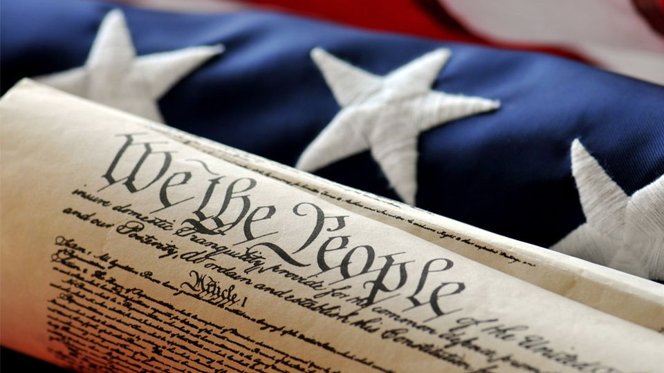
MONDAY, FEBRUARY 11, 2019
TARGET | Identify major domestic and international events during James Madison’s Presidency
BELLWORK | Have out all chapter 10 materials
CLASSWORK | Test Review You will be allowed to retake the chapter 10 test with your materials. The two scores will be averaged together.
HOMEWORK | none

Slide 2
TUESDAY, FEBRUARY 12, 2019
TARGET | Identify major domestic and international events during James Madison’s Presidency
BELLWORK | Name three famous African-American figures, past or present.
CLASSWORK | Black History Month “Influential figures in American society” Match up accomplishment to influential African-Americans in American today or yesteryear Paragraph response question—due by tomorrow!
HOMEWORK | Finish paragraph response, if needed.

Slide 3
WEDNESDAY, FEBRUARY 13, 2019
TARGET | Identify ways new technology changed the way Americans lived
BELLWORK | write down all technology you see in the room (in your bellwork)
CLASSWORK | Reading Essentials - New technologies in the Industrial Revolution Read Lesson One and answer guided questions on margins of reading. If finished, write a response on the back of you packet to the question: Explain three factors that led to the urbanization of the United States during the Industrial Revolution.
HOMEWORK | None

Slide 4
Technology in Mr. Markham’s Room
Computer, document camera, remotes, projector, pencil sharpener, audio/visual equipment, presenter remote, computer docking station, clock, air thermostat, power cord strip, lights, chairs, tables, desks, dry erase board, markers, SmartBoard, wristwatch, pens, pencils, paper

Slide 5
THURSDAY, FEBRUARY 14, 2019
TARGET | Identify major domestic and international events during James Madison’s Presidency
BELLWORK
CLASSWORK
HOMEWORK | None

