Slide 1
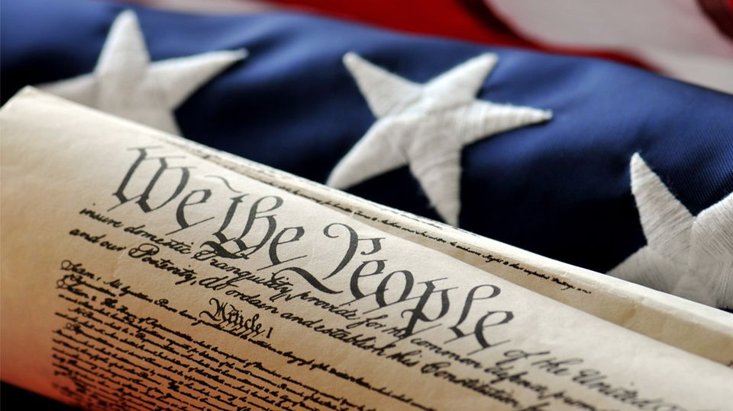
MONDAY, FEBRUARY 4, 2019
LEQ | Identify major domestic and international events during James Madison’s Presidency
BELLWORK | Have out table of contents and conflicts summary chart
CLASSWORK | Three causes for the War of 1812 Finish reading chapter 10 How was the United States unprepared for war? Major battles of the War of 1812
HOMEWORK | Finish four reasons and battles chart

Slide 2
Reasons for war with Britain 1. The U.S. had a small, badly trained army 2. All good commanders/generals were too old to fight 3. Not everyone supported going to war 4. The United States underestimated the strength of the British

Slide 3
WEDNESDAY, FEBRUARY 6, 2019
LEQ | Identify major domestic and international events during James Madison’s Presidency
BELLWORK | Only write the answer today I have two arms, but fingers none. I have two feet but cannot run. I carry well but best with my feet off the ground. What am I?
CLASSWORK | Review War of 1812 Study Guide Kahoot?
HOMEWORK | None

Slide 4
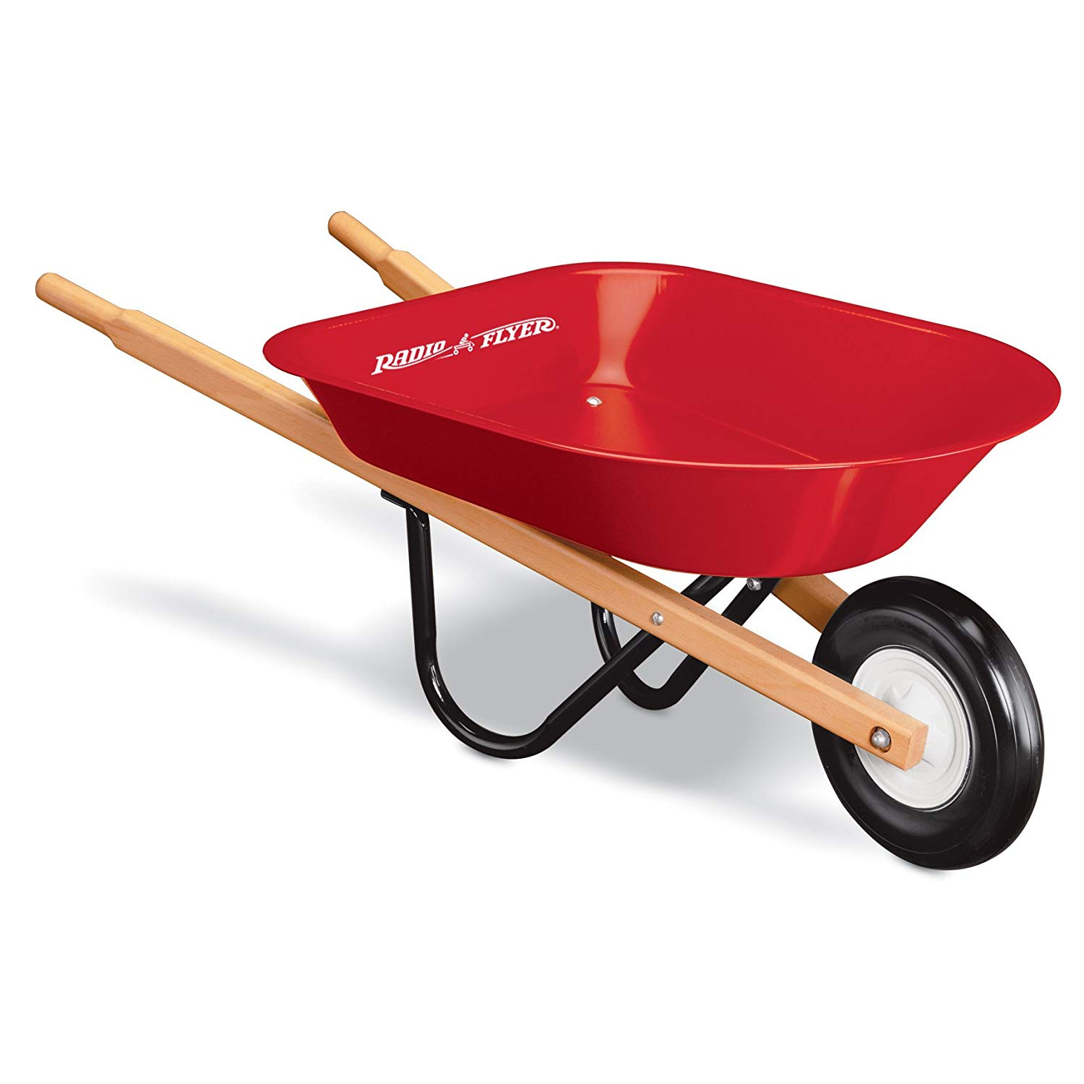

Slide 5
THURSDAY, FEBRUARY 7, 2019
LEQ | Identify major domestic and international events during James Madison’s Presidency
BELLWORK | Have out all materials to review for test (study guide, worksheets, etc.)
CLASSWORK | Complete study guide Review for Chapter 10 Test Quizlet Quizzes Study Guide
HOMEWORK | Study for test

Slide 6
FRIDAY, FEBRUARY 8, 2019
LEQ | Identify major domestic and international events during James Madison’s Presidency
BELLWORK | Have out study guide
CLASSWORK | Study guide should be complete BEFORE the test…. Chapter 10 Test (The Jeffersonian Era) When done, begin reading on to chapter 11….
HOMEWORK | None

