Slide 1
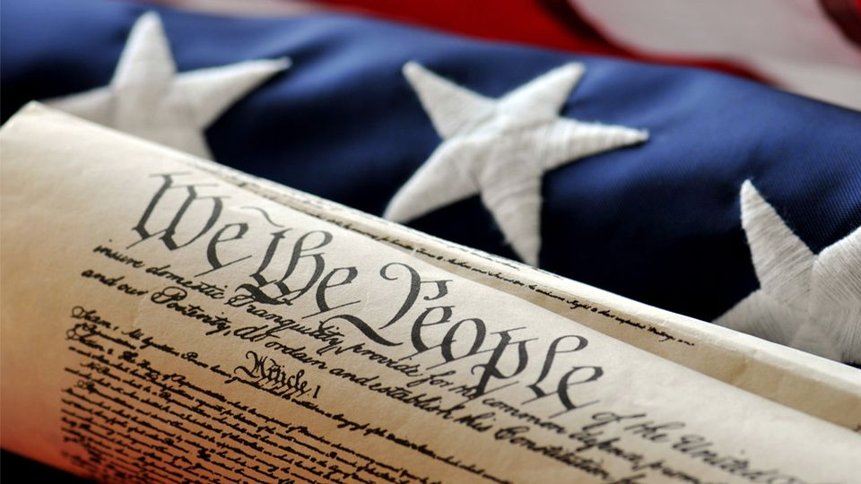
MONDAY, JANUARY 28, 2019
LEQ | Identify major domestic and international events during Thomas Jefferson’s Presidency
BELLWORK | Turn in letter and have out video questions
CLASSWORK | Finish Louisiana Purchase video Complete video questions
HOMEWORK | None

Slide 2
TUESDAY, JANUARY 29, 2019
LEQ | Identify major domestic and international events during Thomas Jefferson’s Presidency
BELLWORK | Who were the Barbary pirates? (p.284)
CLASSWORK | Conflict resumes in the Americas Read Ch. 10, Lesson 3 – Complete with pairs Vocabulary Impressment Embargo
HOMEWORK | Finish summary chart

Slide 3
Who were the Barbary pirates?
Pirates from the Barbary States of North Africa (Morocco, Algiers, Tripoli and Tunis)

Slide 4
WEDNESDAY, JANUARY 30, 2019
LEQ | Identify major domestic and international events during Thomas Jefferson’s Presidency
BELLWORK | Define ‘Impressment’ and ‘Embargo’ in your own words
CLASSWORK | Conflicts at Home and Abroad Share Complete both sides by end of class
HOMEWORK | Finish War at Home column

Slide 5
List causes for war, and identify key people and events
War at Home War Abroad
-Problems with treaties
-Tecumseh (What did he try to do?)
-The Prophet (who was he?)
-William Henry Harrison (who was he)
& Tippecanoe (what happened?)
-British (what were they doing to the United States?)
-Britain (what were they doing in the world?)
-James Madison (what were his concerns?)
-War Hawks (what did they want?)
Which countries actions do you think led more to war---Great Britain or the United States?
You MUST cite evidence to explain your answer.

Slide 6
THURSDAY, JANUARY 31, 2019
LEQ | Identify major domestic and international events during James Madison’s Presidency
BELLWORK | What were the War Hawks plans for gaining new land in the U.S.? (p.290)
CLASSWORK | Finish Conflicts at Home and Abroad Complete reasons for War with Britain Answer final question Review summary chart Quizlet practice
HOMEWORK | Finish back of w.s. – War at home and abroad.

Slide 7
What were the War Hawks plans for gaining new land in the U.S?
War Hawks in Congress desired forest lands in Canada and wanted to invade.

Slide 8
List causes for war, and identify key people and events
War at Home War Abroad
-Problems with treaties
-Tecumseh (What did he try to do?)
-The Prophet (who was he?)
-William Henry Harrison (who was he)
& Tippecanoe (what happened?)
-British (what were they doing to the United States?)
-Britain (what were they doing in the world?)
-James Madison (what were his concerns?)
-War Hawks (what did they want?)

Slide 9
Which countries actions do you think led more to war—Great Britain or the United States?
You must cite specific events and reasons to justify your answer

Slide 10
FRIDAY, February 1, 2019
LEQ | Identify major domestic and international events during James Madison’s Presidency
BELLWORK | Have out conflicts worksheet from yesterday
CLASSWORK | Check w.s. in class Finish extended response – discuss as class Student News, if time.
HOMEWORK | Have a good weekend!

Slide 11
When Finished: -Answer the Extended Response Question -If done, review key terms on quizlet at MarkhamsCorner.weebly.com → History homepage “Chapter 10 study materials”

