Slide 1
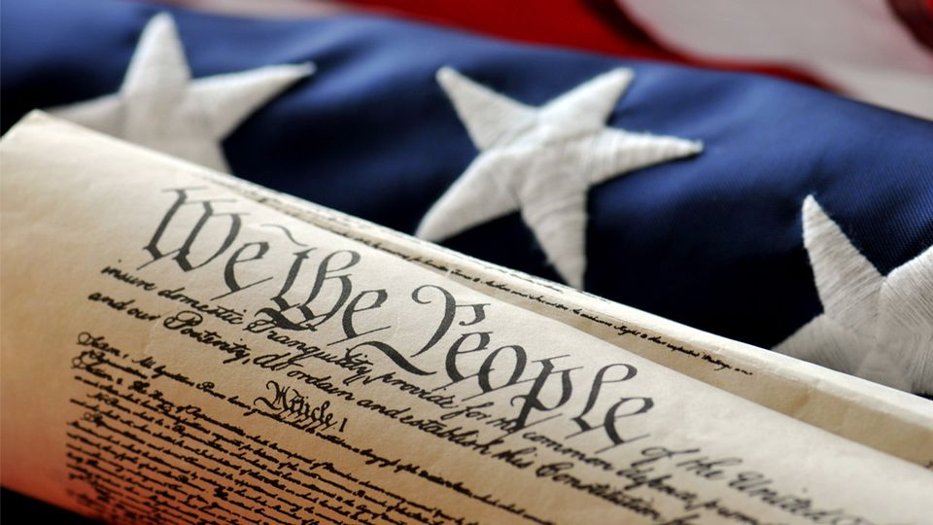
TUESDAY, JANUARY 22, 2019
LEQ | Identify major domestic and international events during Thomas Jefferson’s Presidency
BELLWORK | Explain how Thomas Jefferson became the 3rd U.S. President (minimum 2 sentences) (p. 274-275)
CLASSWORK | Jefferson video The Nation Expands Toussaint rises in Haiti Haitian Revolution (1804) France and President Jefferson make a deal
HOMEWORK | None

Slide 2
Explain how Thomas Jefferson became the 3rd U.S. President Thomas Jefferson and John Adams both ran for President in 1800. The election was a tie and the House of Representatives had to vote to decide the next President. After many votes they decided on Jefferson for President

Slide 3
WEDNESDAY, JANUARY 23, 2019
LEQ | Identify major domestic and international events during Thomas Jefferson’s Presidency
BELLWORK | Why did France sell so much land to the United States? (p.280)
CLASSWORK | Lewis & Clarks Discoveries In teams, discover the adventure of Lewis and Clark through journal entries, documenting all you find in your own log.
HOMEWORK | Finish DBQ planning sheet

Slide 4
Why did France sell the Louisiana Territory to the United States? Emperor Napoleon of France needed money to help fight wars against Great Britain

Slide 5
The Louisiana Territory belonged to Spain, but Americans were allowed to travel down the Mississippi River and trade in New Orleans, which was vital for western farmers.
Because French control of the Louisiana Territory would threaten American trade, Congress offered the French as much as $2 million for New Orleans and West Florida.
Santo Domingo (Haiti) gained independence from France, ending Napoleon’s dream of a Western empire.

Slide 6
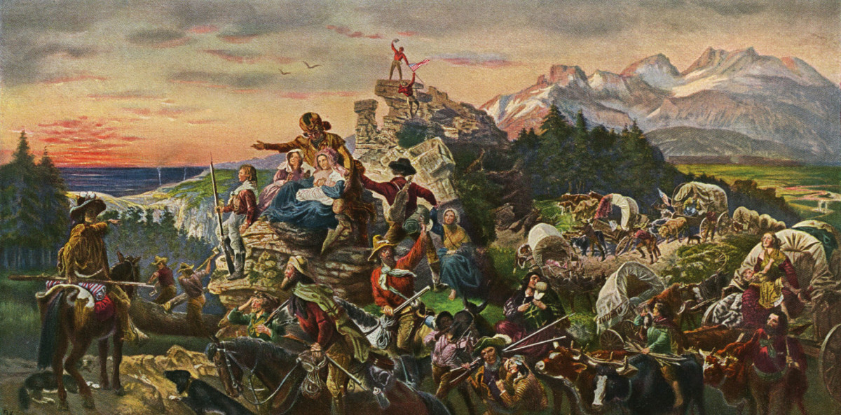
Discovering Lewis & Clark

Slide 7
Background
In 1803, the United States purchased the Louisiana Territory from France, doubling the size of the country. President Jefferson was eager to send an expedition to explore the newly acquired land west of the Mississippi River. He hired Meriwether Lewis and William Clark to lead an expedition across the continent.
Jefferson had three goals for Lewis and Clark.
Establish peaceful relations with the Native Americans.
Find a route across the continent to the Pacific Ocean.
Collect detailed information about western plants, animals, and geography.

Slide 8
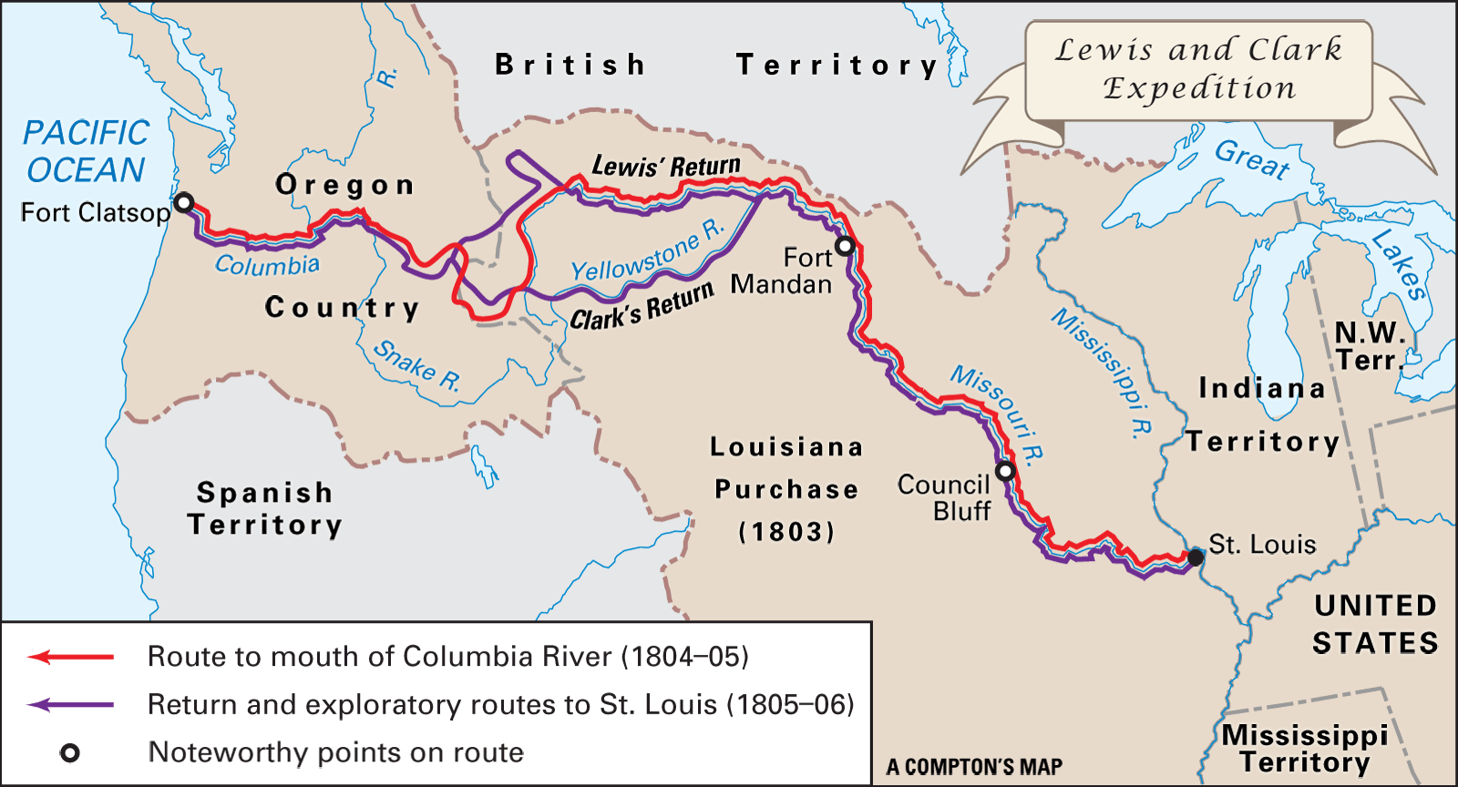

Slide 9
Stations
Lewis and Clark kept detailed journals during their three-year expedition.
Each discovery station contains authentic journal entries written by Lewis and Clark on their famous expedition west.
As you move through the stations, read each journal entry, and record evidence of Lewis and Clark’s finding in the correct column of you data collection page.

Slide 10
Statio

Slide 11
THURSDAY, JANUARY 24, 2019
LEQ | Identify major domestic and international events during Thomas Jefferson’s Presidency
BELLWORK | Have out Louisiana Purchase data log and table of contents
CLASSWORK | DBQ Response “Based on the journal entries of Lewis and Clark, did the expedition achieve its goals?” Write a letter home to a family member detailing your adventure west. Include the plants, animals, peoples and geography you experienced along the way.
HOMEWORK | None

Slide 12
Directions
Write a letter home to a family member or loved one describing your journey out west. Remember to include some of the plants, animals, people and geography you experienced along the way. Would you make the trip again?
Why or why not?
Keep the thee goals of the expedition in mind when writing your response.
President Jefferson’s Goals
Establish peaceful relations with the Native Americans.
Find a route across the continent to the Pacific Ocean.
Collect detailed information about western plants, animals, and geography.

Slide 13
-Opening sentence (explain why you’re there)
-Main Body (must include details about the plants, animals, peoples
and geography of the Louisiana Territory)
-Closing (would you go on the expedition again? Why or why not?
Answer whether the expeditions goals were accomplished)
Final letter must be at least TWO paragraphs
President Jefferson’s Goals
Establish peaceful relations with the Native Americans.
Find a route across the continent to the Pacific Ocean.
Collect detailed information about western plants, animals, and geography.

Slide 14
FRIDAY, JANUARY 25, 2019
LEQ | Identify major domestic and international events during Thomas Jefferson’s Presidency
BELLWORK | A one-seeded fruit I may be, but all of your calendars are full of me. What am I?
CLASSWORK | Video – The Louisiana Purchase Complete guided video questions
HOMEWORK | Lewis & Clark Letter due on Monday

Slide 15
A one-seeded fruit I may be, but all of your calendars are full of me. What am I? Dates

