Slide 1
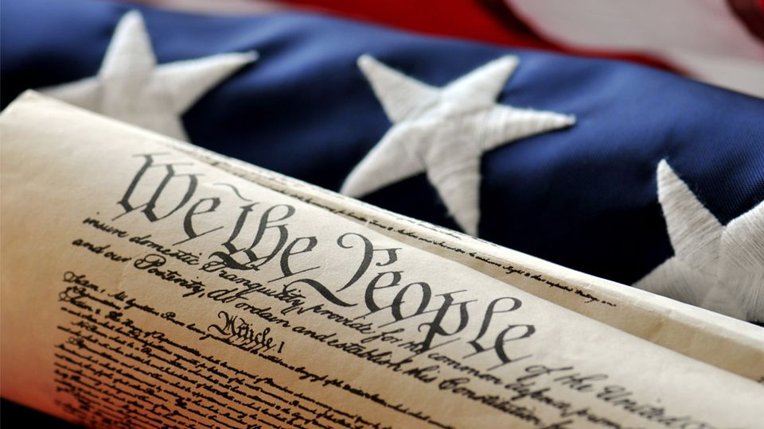
MONDAY, JANUARY 14, 2019
LEQ | Analyze the impact of John Adams’ Presidency
BELLWORK | Have out review materials
CLASSWORK | Review for Chapter 9 Test
HOMEWORK | Study for Quiz

Slide 2
TUESDAY, JANUARY 15, 2019
LEQ | How did George Washington’s presidency impact the formation of a new nation?
BELLWORK | Title a sheet of paper “Chapter 9 Test”. Number it 1-27 Do not write this bellwork.
CLASSWORK | Chapter 9 Test Turn in 9.3 Guided Reading worksheet when finished
HOMEWORK | None

Slide 3
WEDNESDAY, JANUARY 16, 2019
LEQ | Analyze the impact of John Adams’ Presidency
BELLWORK | What was the result of the Election of 1800?
CLASSWORK | Update Table of Contents Video: Thomas Jefferson’s Presidency
HOMEWORK | None

Slide 4
THURSDAY, JANUARY 17, 2019
LEQ | Identify major domestic and international events during Thomas Jefferson’s Presidency
BELLWORK | What was the result of the Election of 1800? (p.274-275)
CLASSWORK | The Jeffersonian Era Review John Adams Election of 1800 Complete Jefferson’s vision
HOMEWORK | Finish page 1 guided reading, if needed

Slide 5
What was the result of the Election of 1800? There was a tie vote for President of the United States. The House of Representatives elected Thomas Jefferson

Slide 6
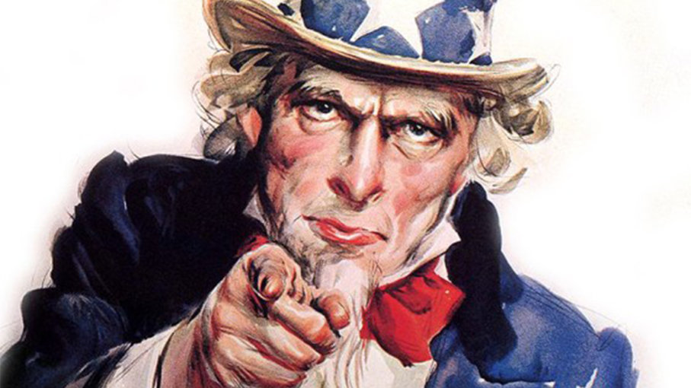
How do Presidents gain support today?
Travel to other states
Give speeches
Debate other candidates
Mail out flyers/call families

Slide 7
Get out your textbooks. Go to page 274.

Slide 8
FRIDAY, JANUARY 18, 2019
LEQ | Analyze the impact of John Adams’ Presidency
BELLWORK | How did candidates run for office in early America?
CLASSWORK | Finish election of 1800 The Supreme Court Judicial Review – effect on the United States CNN10 – time permitting
HOMEWORK | Finsih 10.1 worksheet

Slide 9
How did candidates run for office in the early 1800’s? Candidates sent out hundreds of letters to community leaders in order to get support.

Slide 10
Complete 10.1 Guided Reading pages 274-277

