Slide 1
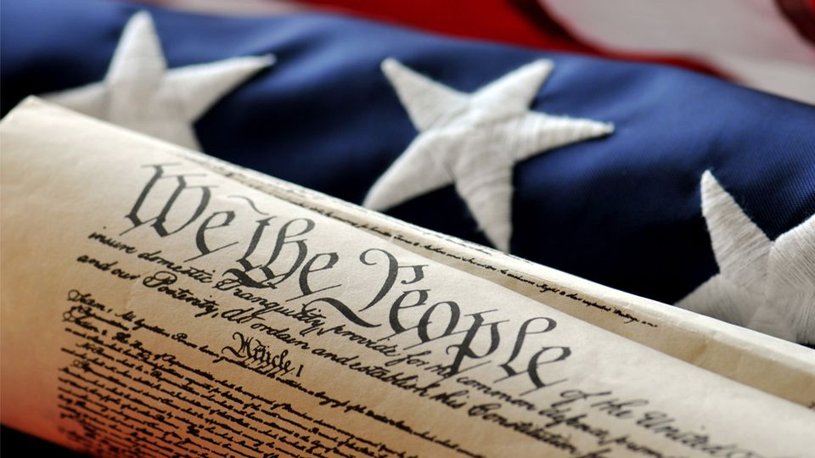
MONDAY, JANUARY 7, 2019
LEQ | How did George Washington’s presidency impact the formation of a new nation?
BELLWORK | Share stories from break!
CLASSWORK | Review Washington’s Presidency Begin Lesson 2 on problems facing the United States Begin first questions
HOMEWORK | Reading Essentials, Lesson 2 due Wednesday

Slide 2
Define our terms from last year…..
Cabinet ____________________________________
Precedent __________________________________
Supreme Court ____________________________

Slide 3
Define our terms from last year…..
George Washington________________________
Articles of Confederation ____________________________________________________________________________________________

Slide 4
Define our terms from last year…..
Tariff ___________________________________________
Judiciary Act __________________________________________________________________________________________________

Slide 5
TUESDAY, JANUARY 8, 2019
LEQ | How did George Washington’s presidency impact the formation of a new nation?
BELLWORK | Have out folder and old Table of Contents
CLASSWORK | Clean out folders Early Rebellions Putting down the Whiskey Rebellion Foreign Policy Effects of the issues – group response “Washington’s Farewell address”
HOMEWORK | Reading Essentials due tomorrow

Slide 6
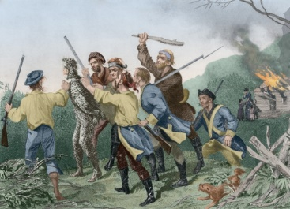
Early rebellions in the Nation
The federal government used its new power to stop the Whiskey Rebellion.
Conflicts between Native Americans and American settlers led to a U.S. defeat in a battle in the Northwest Territory.
General Anthony Wayne defeated the Native Americans in the Northwest Territory and forced the Treaty of Greenville in 1795.

Slide 7
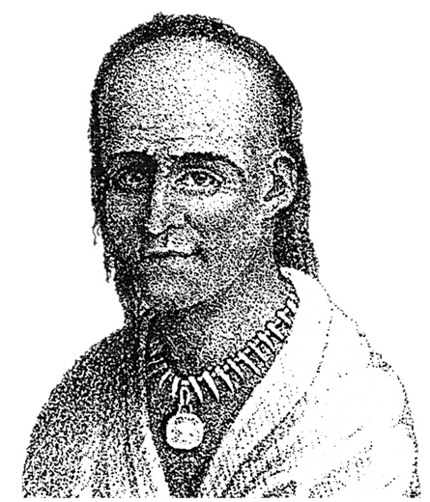
Little Turtle gives up….
Little Turtle was chief of the Miami Tribe.
He fought on the side of the British during the American Revolution.
Afterward, he led his people against the new United States in an effort to hold onto their land in the Northwest Territory.

Slide 8
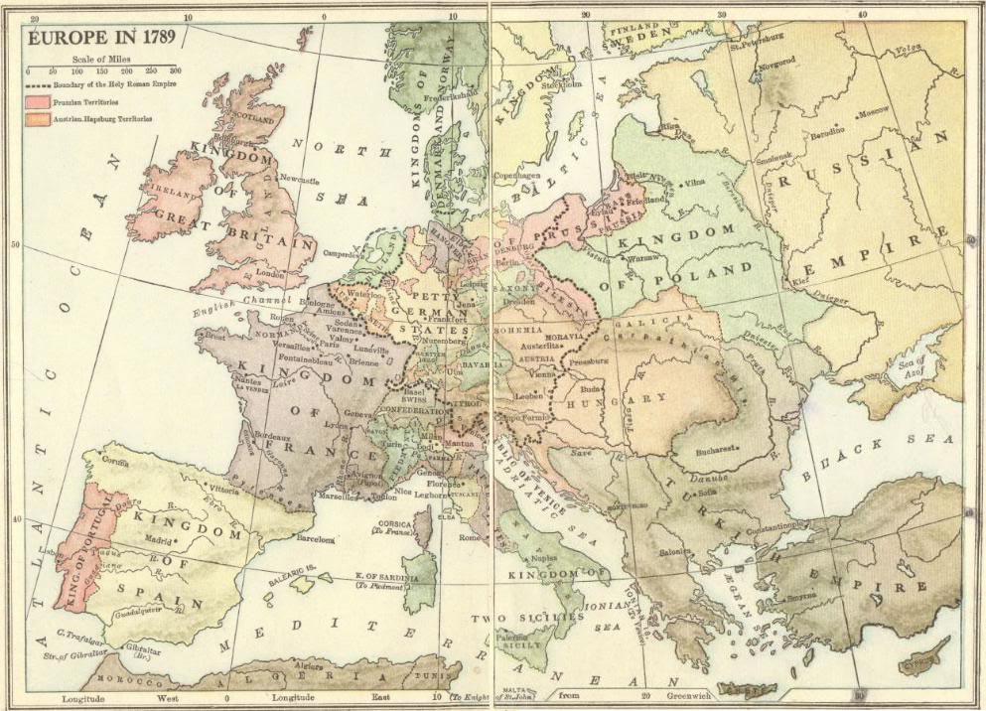
Foreign Policy
President Washington pushed for neutrality concerning British and French conflicts.
Why might the United States want
to remain neutral in Europe?
British ships began the practice of
Impressment, or forcing
American sailors into the British
Navy that traded with France.

Slide 9
Treaty of Greenville
On your own sheet of paper, fill in the effects of the following events:
Pages 259-261
*Include important historical figures involved next to your answers.
Jay’s Treaty
Pinckney’s Treaty

Slide 10
WEDNESDAY, JANUARY 9, 2019
LEQ | How did George Washington’s presidency impact the formation of a new nation?
BELLWORK | Describe the United States policy of ‘neutrality’ in 2 sentences (p. 260)
CLASSWORK | Finish work from yesterday – 10 minutes Reading Essentials DUE “Washington’s Farewell Address”
HOMEWORK | None

Slide 11
Describe the United States’ policy of “Neutrality” in two sentences. The United States would not be for or against any conflicts. The United States was brand new and could not risk getting involved.

Slide 12
Treaty of Greenville
On your own sheet of paper, fill in the effects of the following events:
Pages 259-261
*Include important historical figures involved next to your answers.
Jay’s Treaty
Pinckney’s Treaty

Slide 13
THURSDAY, JANUARY 10, 2019
LEQ | How did George Washington’s presidency impact the formation of a new nation?
BELLWORK | Write what you think a ‘political party’ is. Share your answer
CLASSWORK | The First Political Parties Read 9.3 and discuss the fist political parties Begin guided reading
HOMEWORK | Finish page 1

Slide 14
Write what you think a ‘political party’ is and share
A group of people that agree on the same issues in the government.

Slide 15
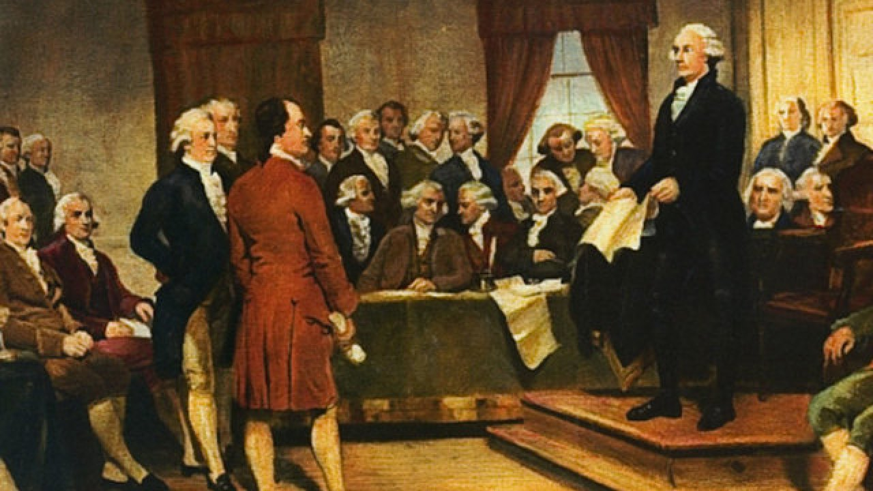
In President George Washington’s
farewell address to the nation,
he warned that
political parties would
not be good for the
Country
Chapter 9, Lesson 3

Slide 16
FRIDAY, JANUARY 11, 2019
LEQ | How did George Washington’s presidency impact the formation of a new nation?
BELLWORK | Two in a corner, one in a room, zero in a house and one in a shelter. What am I?
CLASSWORK | Complete Guided Reading 9.3 Review in class Video: President John Adams
HOMEWORK | None

Slide 17
Question Answer

